Slide 1


ILORIN
INNOVATION
HUB
June 2025 PROJECT UPDATE

Slide 2

Establishing Ilorin Innovation Hub to Catalyse Regional Innovation and Entrepreneurship in Nigeria
Ilorin Innovation Hub is being activated as a regional catalyst for innovation in Nigeria, with the goal of strengthening the local digital economy and nurturing high-potential startups that address pressing societal challenges. Powered by IHS Nigeria and in partnership with CcHUB, this initiative is laying the foundation for a thriving, inclusive, and resilient innovation ecosystem across Kwara State and neighbouring states.
Current efforts are centred on deepening ecosystem engagement, hosting roadshows and high-impact community events, and delivering the Innovation Challenge and Hackathon programmes. These activities are designed to build startup capacity, facilitate collaboration, and drive scalable innovation across key sectors such as AI, HealthTech, GreenTech, EdTech, Big Data, and Creative Technologies.
Project Overview

Slide 3
Key Objectives
Strengthen the Hub’s position as a leading regional innovation center.
Map the ecosystem and articulate stakeholder ambitions to inform programme design
Drive ecosystem activation through ongoing roadshows and high-impact community events
Design and implement inclusive Innovation Challenge and Pre-Incubation programmes
Facilitate startup capacity development, mentorship, and access to funding opportunities
Monitoring programme delivery to ensure alignment with impact goals
These activities are currently in motion and are intended to culminate in a robust innovation pipeline, stronger regional tech capacity, and a sustainable foundation for digital entrepreneurship in Kwara State and beyond.

Slide 4
IIH Community Events with Expected Outcomes & Impact Metrics
Category | Description | Expected Outcomes | Results | Formats
Capacity Development | Workshops and training sessions focused on skill development in areas | Build technical knowledge in AI, deep learning, big data, and data visualization. Equip participants with hands-on skills to build prototypes or solutions. Strengthen the local developer talent pool in emerging tech. | 300+ total participants trained across sessions. 80% of participants show improved technical understanding (feedback forms). 150+ Join the “IIH Developers Group” for continued learning. | Ilorin Dev Box Workshops Masterclasses Series
Thought Leadership | Panel discussions, keynote talks, and fireside chats featuring industry experts, policymakers & entrepreneurs sharing insights and trends. | Deepen sector-specific innovation skills (HealthTech, Startup Support, GovTech). Connect participants to real-world problems Facilitate knowledge sharing with experts to raise sectoral competence. Form early-stage, sector-based communities of practice | 1000+ participants engaged across HealthTech, FinTech, GovTech, and startups. 2 new micro-communities (e.g., Health Innovators, AI Innovators) formed. 80% satisfaction and relevance score from participants. | Female Focus Catalyst Events Fireside Chats
Sector/ Industry Specific | Specialised sessions for industries like fintech, agritech, healthtech, and creative industries to facilitate knowledge exchange and targeted ecosystem development. | Inspire current and aspiring founders through lived experiences and storytelling. Share hard-earned lessons on startup growth, pivots, and resilience. Encourage mentorship-seeking behavior among early-stage entrepreneurs. | 1000+ founders and aspiring entrepreneurs engaged. 10+ participants report strategic clarity or pivot insights. 15+ founders initiate follow-up discussions with founders. | Builder’s Path Product Showcase Design Sprints (HCD) Roundtables/Breakfast Chats
Networking | Community-building activities, investor meetups, and corporate-startup engagement sessions to foster relationships and collaboration. | Enable connections across tech, creative, and academic sectors. Foster community belonging and peer support. Encourage founder-to-founder collaboration and informal learning. Surface common challenges to guide programme design and support. | 800+ total attendees across networking events. 60% of attendees report making at least one meaningful new connection (through survey or feedback forms). 10+ new members integrated into programmes or co-working space. | Meet and Mingle Events

Slide 5
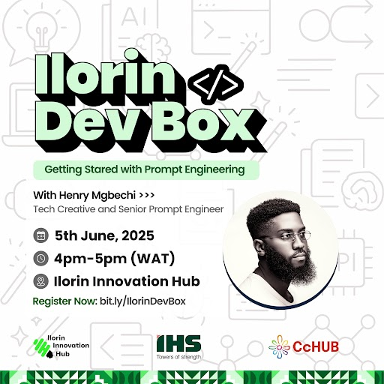
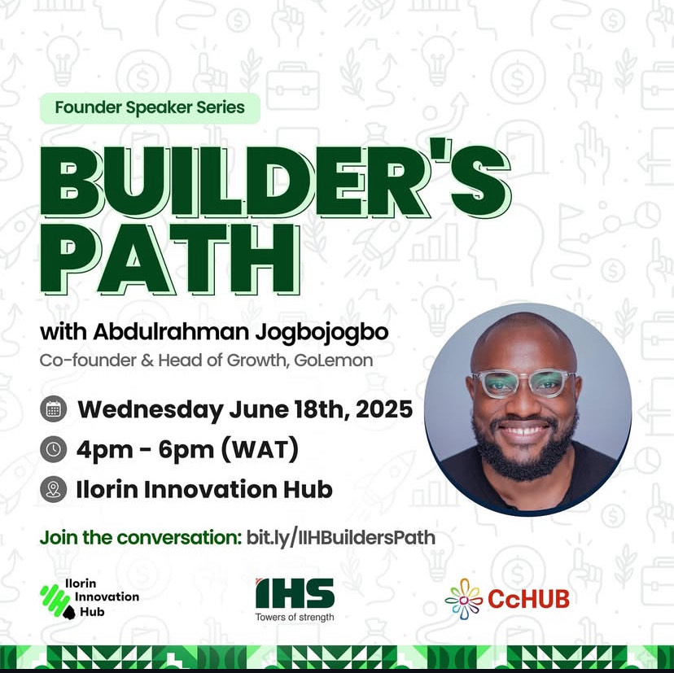
Completed Activities in June
S/N | Activity | Goal | Expected Outcome | Participants | Target | Strategic Alignment
1. | Ilorin Dev Box: Getting Started with Prompt Engineering I (June 13) | To introduce participants to foundational concepts in AI prompt engineering, provide hands-on experience with generative AI tools, and build a developer community centred on AI literacy | Improved technical literacy in AI tools and activated local developer interest | 54 Participants (Developers, students, tech enthusiasts) | 30 | Technical Capacity Building, Developer Ecosystem Activation
2. | Founder Speaker Series: Builder’s Path with Abdulrahman Jogbojogbo (June 18) | To inspire and equip local founders through real-life startup journeys, practical scaling lessons, and mentorship-driven community building | Exposure to startup realities and access to founder insights and mentorship pathways | 41 Founders, students, aspiring entrepreneurs | 50 | Entrepreneurial Mindset Shift, Community Cohesion
3. | Ilorin Dev Box: Getting Started With Prompt Engineering II (June 20) | Advance participants’ technical understanding of AI prompt engineering, encourage real-world application, and introduce advanced strategies for coding and business use | Practical application of advanced prompt design; preparation for innovation challenge use cases | 41 Developers, early-stage builders, tech enthusiasts | 30 | Technical Deepening, Innovation Readiness

Slide 6
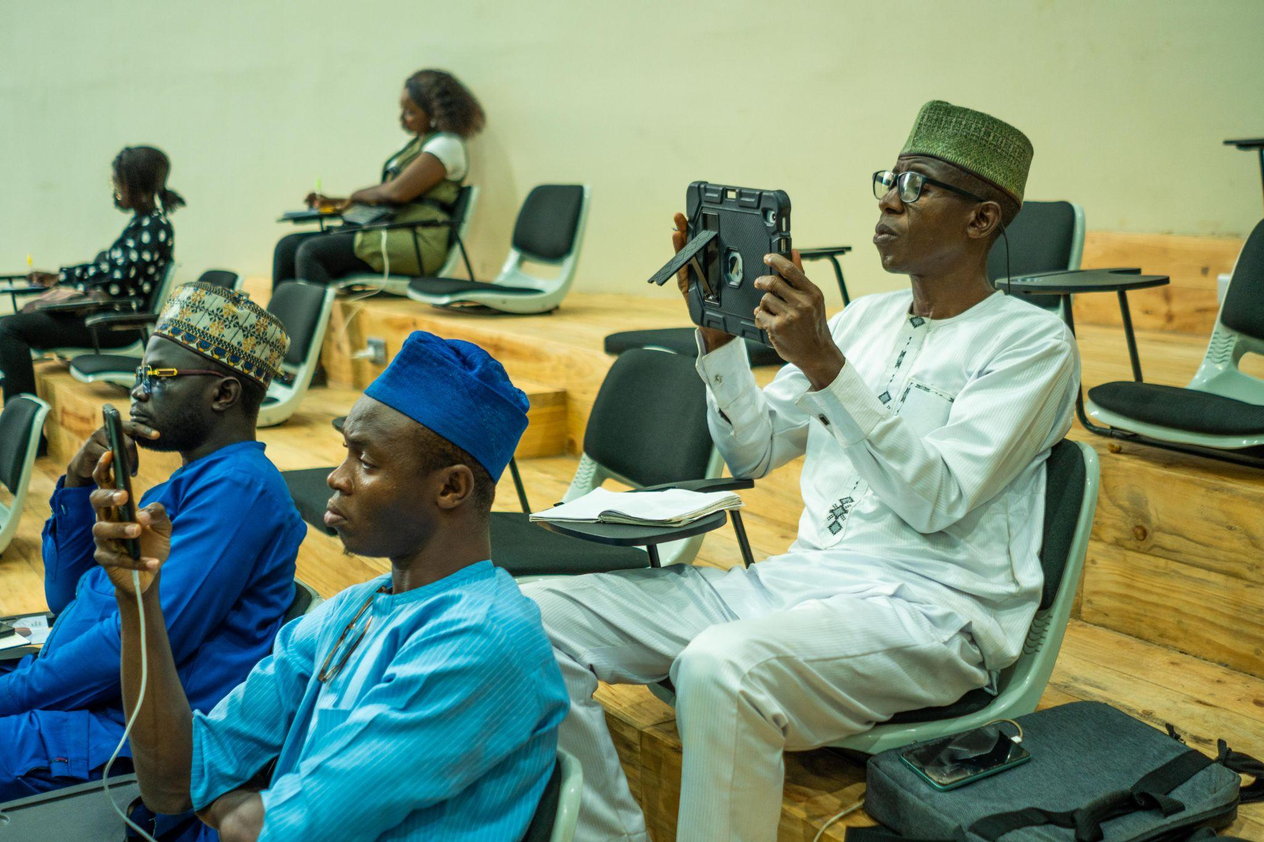
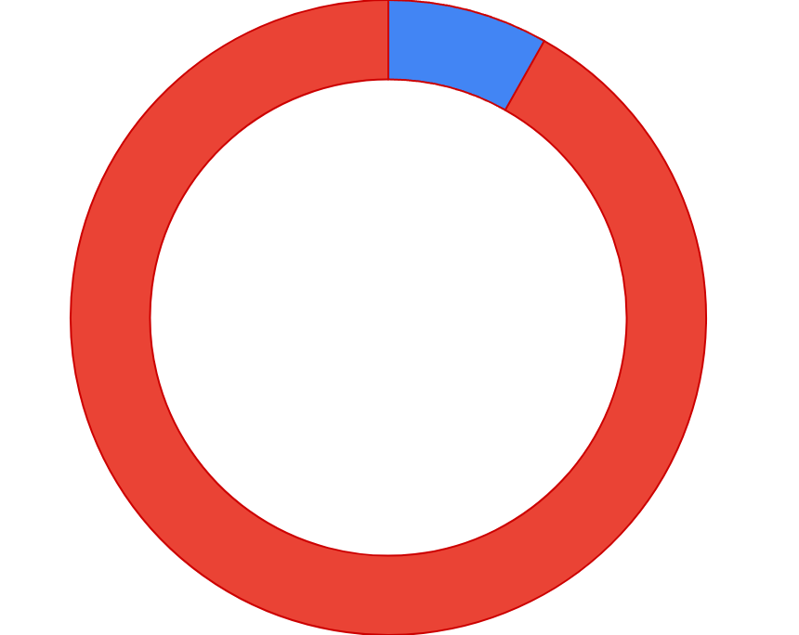
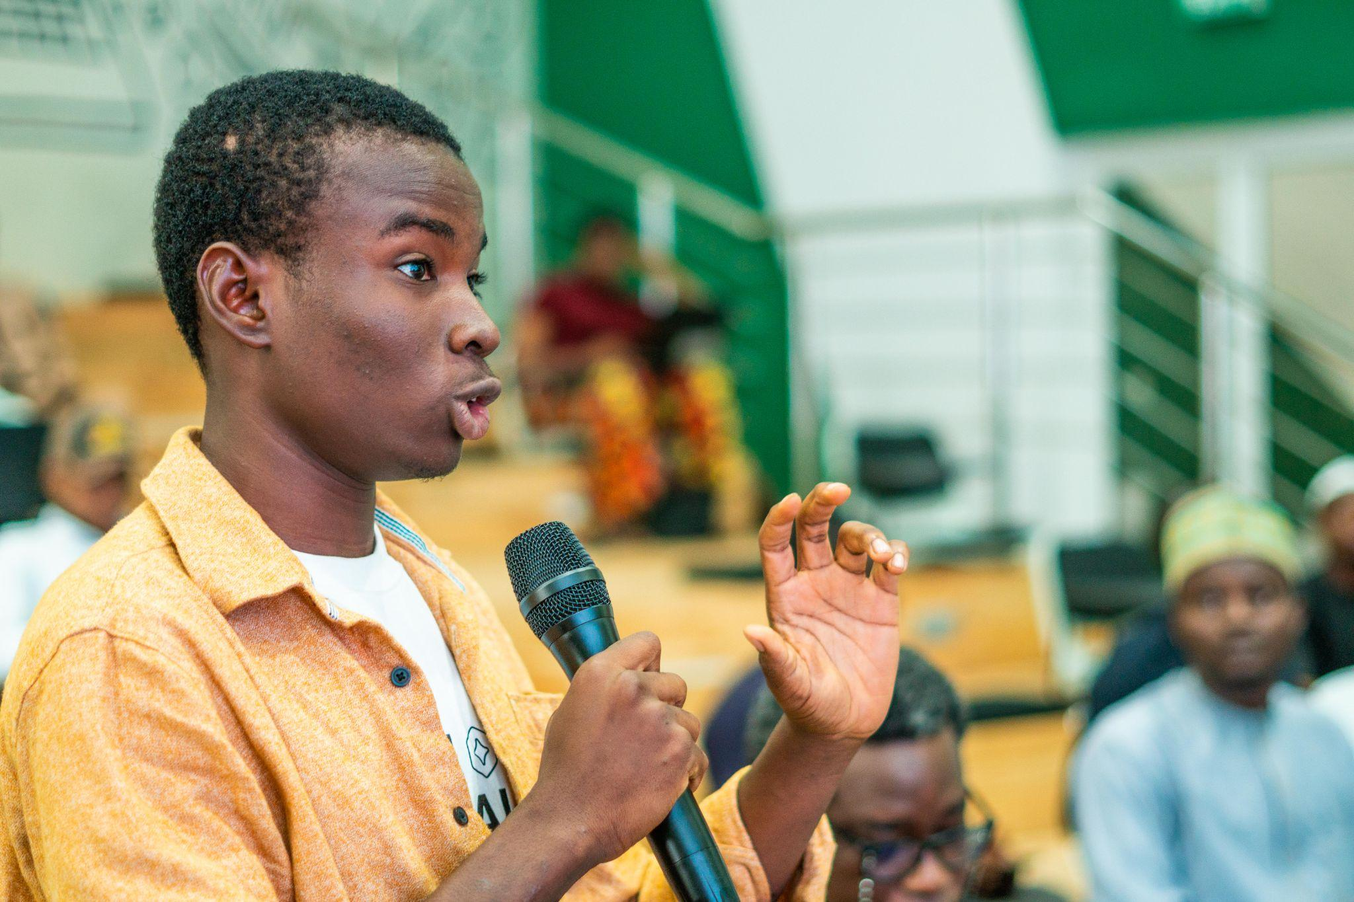
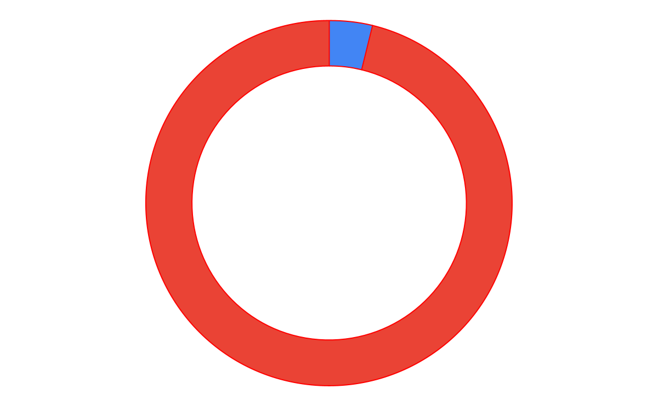
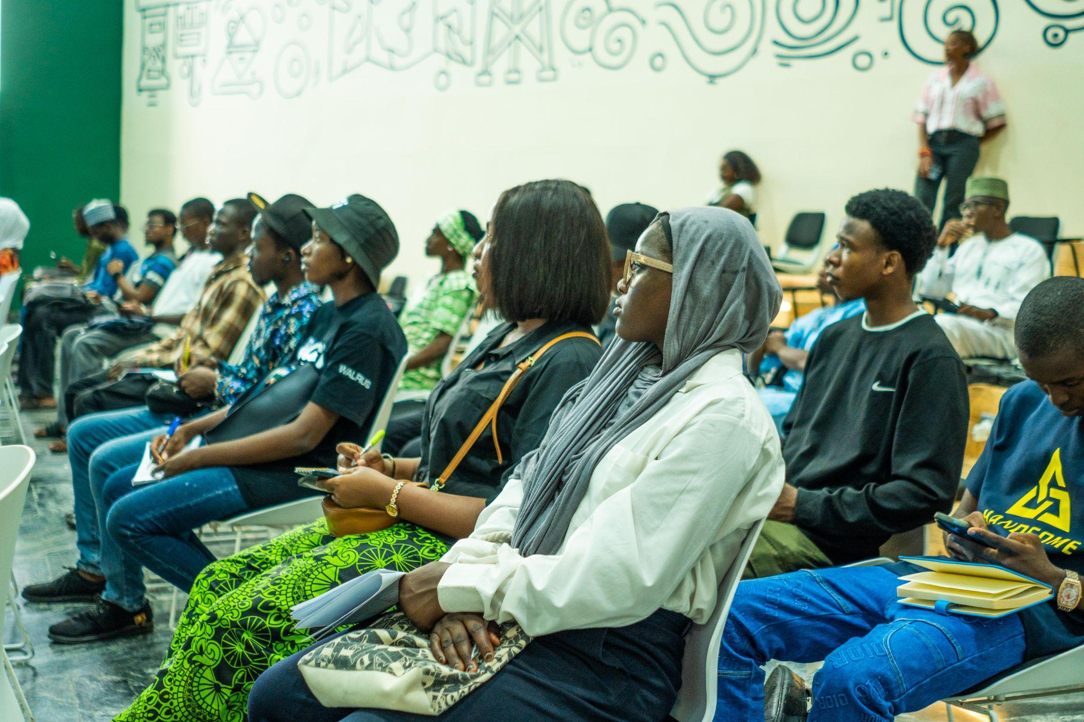
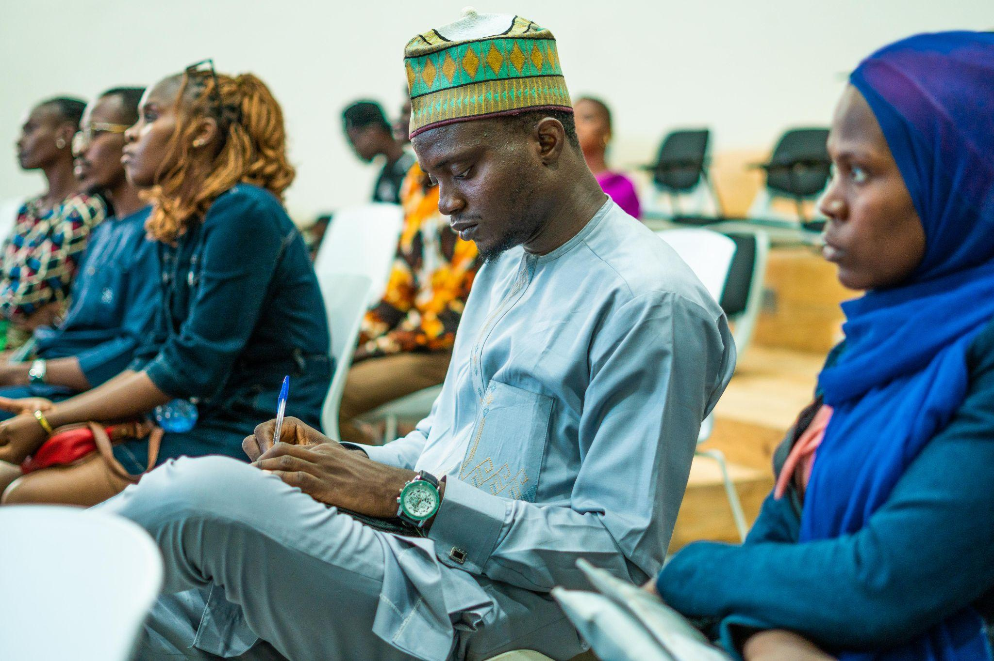
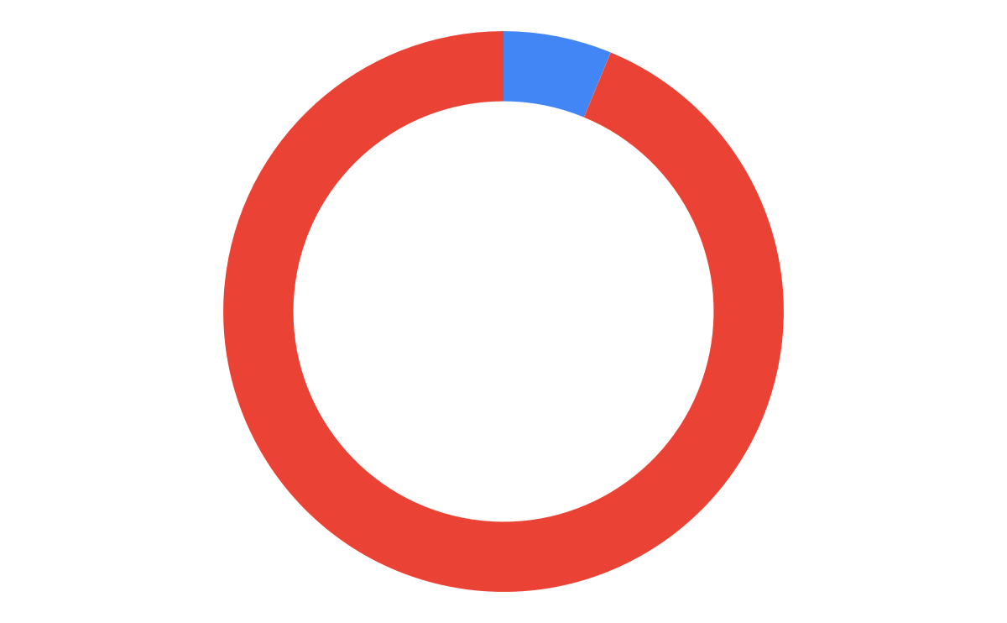

Overall Progress
Capacity Development
9%
Community Events
6/40
Sector-Focused Events
4%
Community Members
Thought leadership Events
695/5000
7%
Networking Events
0%

Slide 7
Key Outputs & Metrics
Metric | Value
Total Activities/Events so far (May/June) | 8/40
Virtual Town Hall | 324
AMA Session with Temi Kolawole | 50+
Focus Group Participants | 25
Key Informant Interviews Conducted | 9
Fireside Chat with Iyin Aboyeji | 138
Getting Started with Prompt Engineering I | 54
Founder Speaker Series: Builders Path with Abdulrahman Jogbojogbo | 41
Getting Started with Prompt Engineering II | 41
Total Stakeholder Engagements (FGD + KII + AMA + Fireside, Builders Path, Getting Started with Prompt Engineering I and II) | 695
Activities Conducted in May | 5 (Virtual Town Hall, AMA, FGD, KII, Fireside)
Activities for June | 4 (Builders Path, Getting Started with Prompt Engineering I and II, Designing for Impact I)

Slide 8
UPCOMING ACTIVITIES

Slide 9
Community and Ecosystem Engagement
Upcoming Activity/Event | Goal | Participants | Expected Outcome | Expectations for Reporting
Masterclass: Designing for Impact 1 (June 30, 2025) | Tackle public health challenges through human centered designing (innovative co-creation) | Innovators, healthcare professionals, ecosystem actors. | Participants apply human-centered design to health challenges and co-create early-stage solutions in a collaborative environment. | Document workshop design, participant feedback, and solutions explored.
Meet & Mingle: Founders & Entrepreneurs (July 4, 2025) | Facilitate founder networking, relationship building, and collaboration opportunities. | Founders, entrepreneurs, innovation ecosystem members. | Enhanced peer collaboration and new relationship-building among founders, creatives, and tech professionals. | Report participant numbers, partnerships initiated, and engagement highlights.
Innovation Challenge & Hackathon Call for Applications (June 26–July 27, 2025) | Attract top innovations for hackathon and innovation challenge. | Innovators applying across AI, HealthTech, GreenTech, Creative Economy, etc. | Attract over 100 quality applications from eligible innovators and startups | Track application numbers, fields of innovation, applicant diversity, and outreach reach.
Innovation Challenge Roadshow (June 30th-July 25th) | Drive statewide mobilisation and awareness for the programme across 8 states. | Tertiary institutions, tech hubs, entrepreneurs across Kwara → Niger → FCT → Kogi → Ekiti → Ondo → Osun → Oyo | Strong visibility across 8 states and a diverse, high-quality pipeline of applicants across priority innovation sectors. | Track number and diversity of participants engaged across locations;, questions asked, institutions visited, outreach effectiveness per state.

Slide 10

Innovation Challenge and Pre-Incubation Program
Innovation Challenge and Hackathon
Goal
To build a pipeline of scalable, impact-driven ventures by equipping local innovators and startups with the mentorship, resources, and ecosystem access needed to develop technology solutions that address critical socio-economic challenges across priority sectors.
Key Dates
Applications open: July 10th – August 11th, 2025
Roadshow Dates: Date July 11th-July 30th
Hackathon: September 2nd-4th
Incubation/Pre-Incubation: September – December 2025
Focus Areas
AI and Disruptive Technologies and Solutions
CleanTech
HealthTech
Higher Education Innovation
Education Technologies (EdTech)
Digital Studio and Creative Technologies
Connectivity and Big Data Solutions

Slide 11
Innovation Challenge and Pre-Incubation Program
Innovation Challenge and Hackathon Impact Metrics
Over 200 applications for the hackathon and innovation challenge
Registration Link: https://bit.ly/IIHInnovationChallenge2025
Roadshow begins (June 30th)
Kickoff at the University of Ilorin.
Other 8 states involved in the roadshow: Kwara → Niger → FCT → Kogi → Ekiti → Ondo → Osun → Oyo
1500+ direct engagements with students, entrepreneurs, founders, startups, ecosystem players
Roadshow: Kwara State (Locations)
University of Ilorin
Mal Hub
Kwara State University
Landmark University
Thomas Adewumi University
Al-Hikmah University
10,000 indirect/indirect engagement - Social Media
- Universities
- Newsletters (universities
- Media mentions/ Blog

Slide 12
THANK
YOU!

